Slide 1
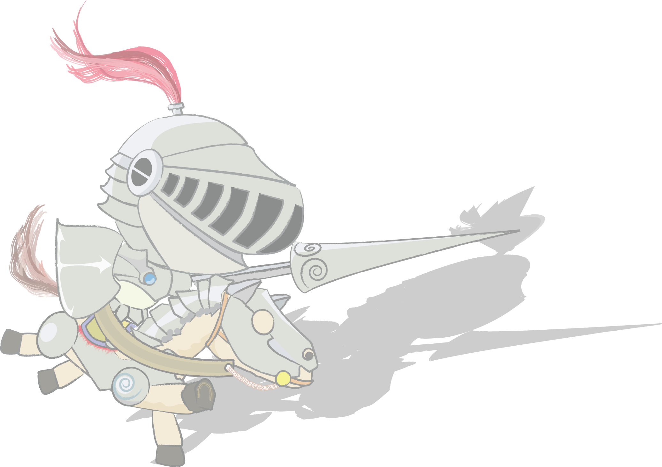
Report 17 Kelvin's dropper
Franklin Liou

Slide 2
Problem # 17
Kelvin’s Dropper
Construct Kelvin's dropper. Measure the highest voltage it can produce. Investigate its dependence on relevant parameters.

Slide 3
Overview
Introduction
Observation
Problem Analysis
Experiment
Experiment Setup
Experiment
Results and Discussion
Conclusions & Summary
References

Slide 4
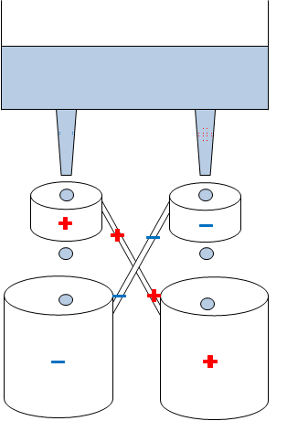
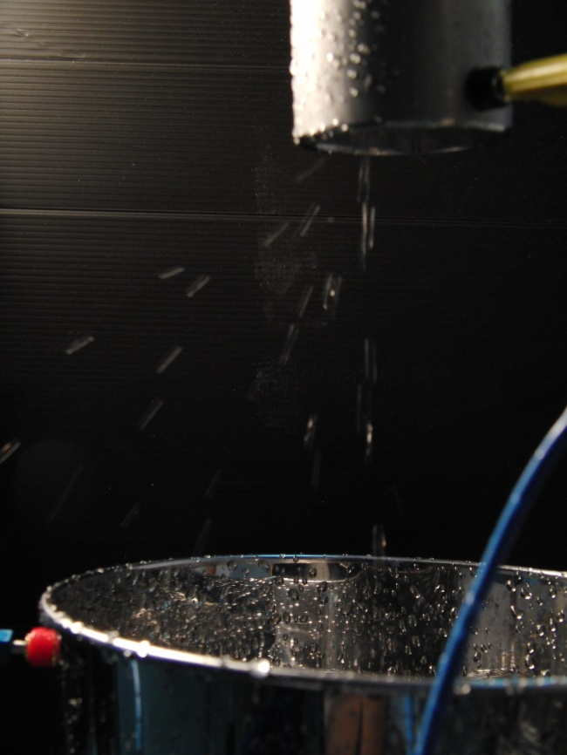
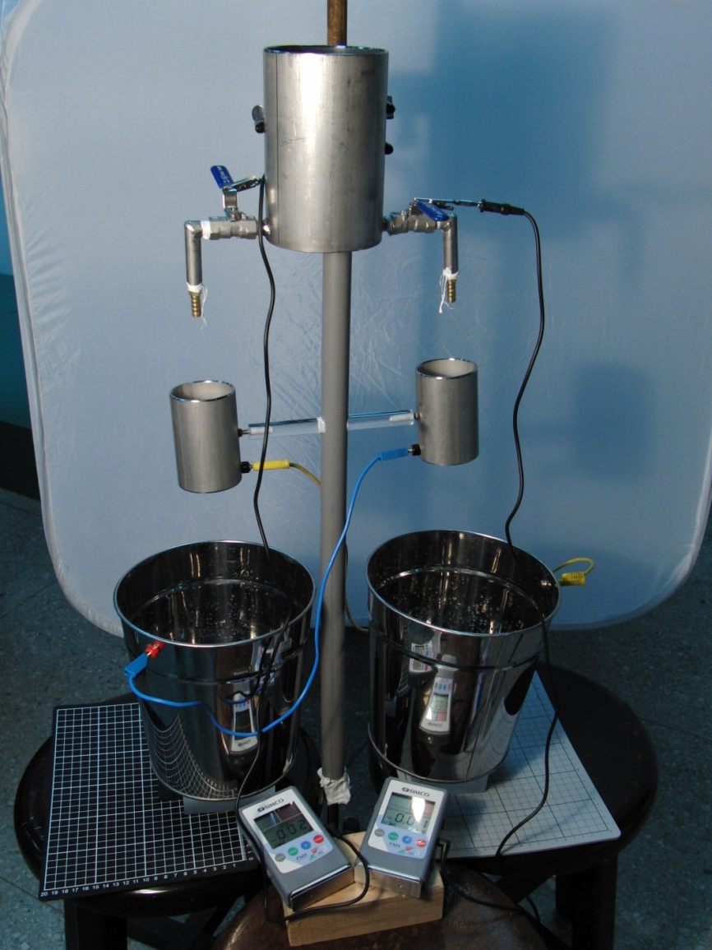
Observation

Slide 5
Problem Analysis
P

Slide 6
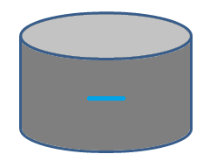
Problem Analysis
Charged object can induce charge separation in droplets
Droplets separated from stream can hold charge

Slide 7
Problem Analysis
Instability in separation causes imbalance in charge between the two sides
Self-amplifying process

Slide 8
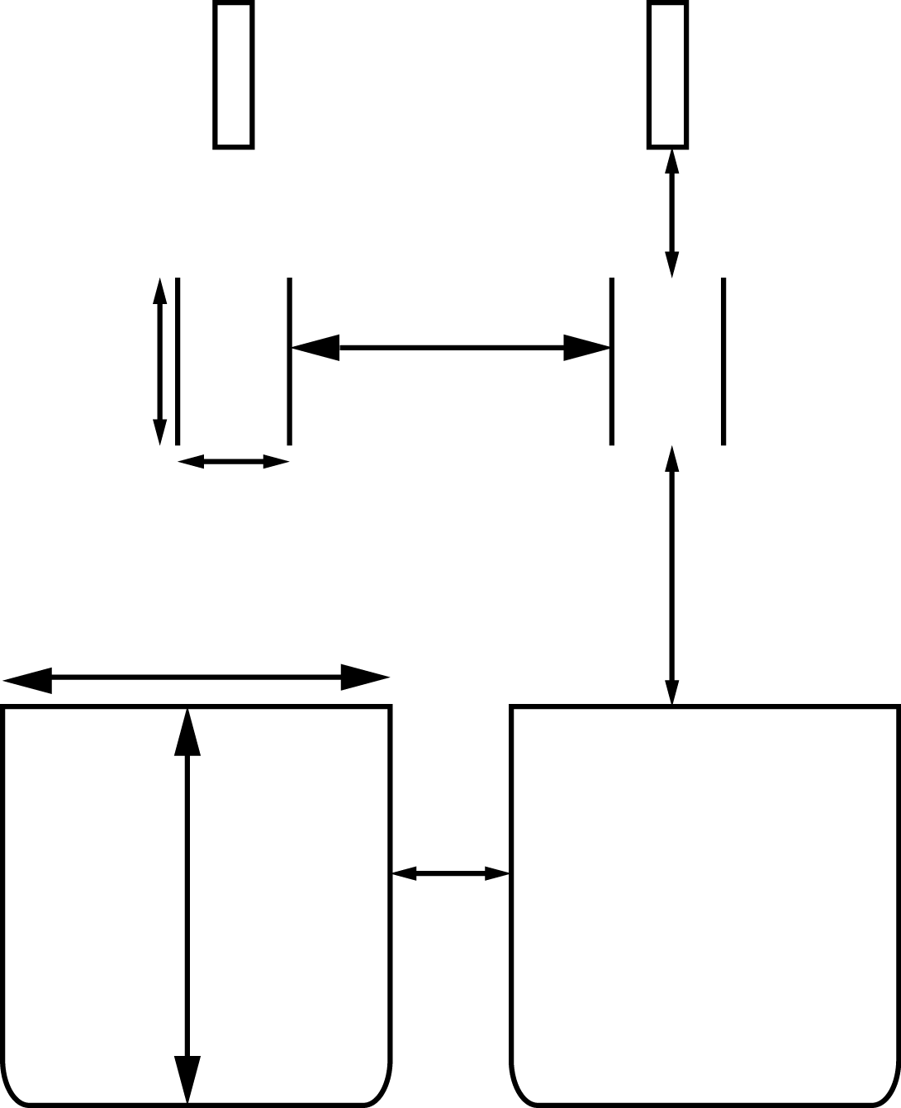
Experiment
Parameters:
Ring position
Ring diameter
Water velocity: a pump is used to control the flow of water
7cm
17.3cm
9cm
6cm
14cm
20.8cm
21.4cm
6.5cm

Slide 9
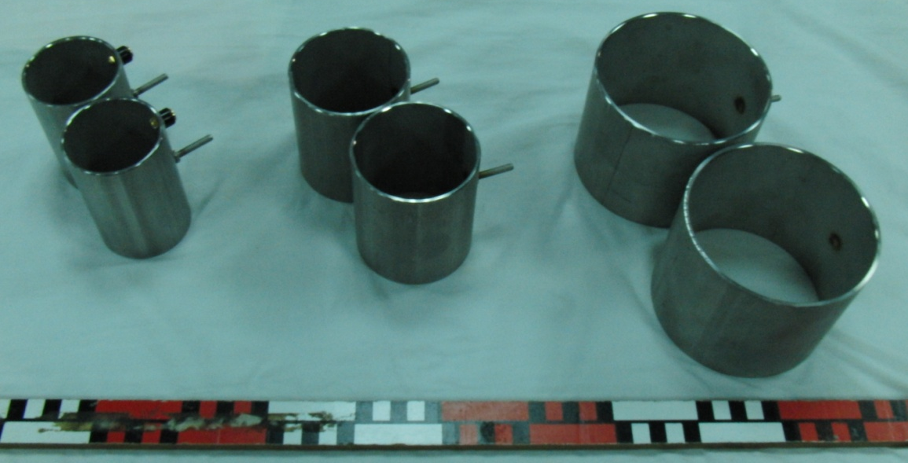
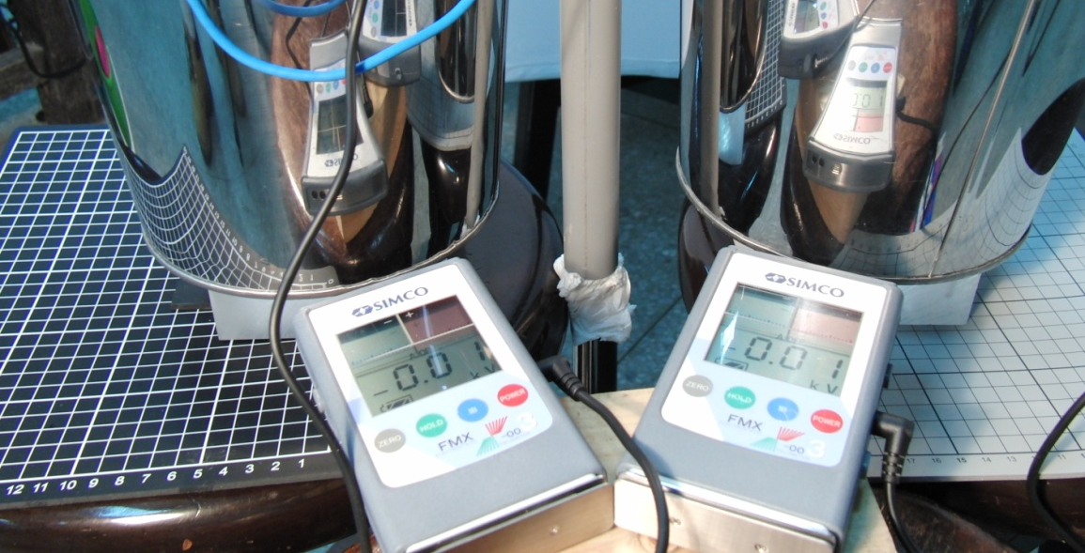
Experiment Setup
Rings of different diameter
Static voltage measuring device

Slide 10
The Charging Curve
Fluctuations
The initialization of the voltage climb is approximately an exponential growth
The curve fluctuates at the maximum voltage

Slide 11
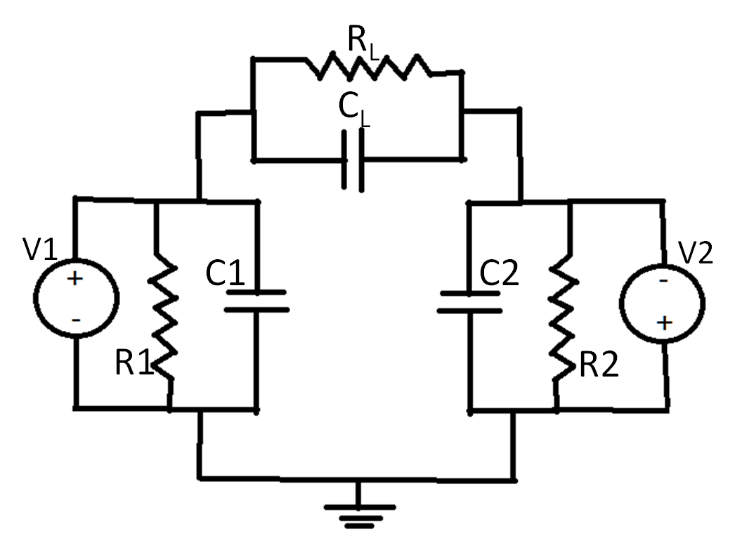
The Charging Curve

Slide 12
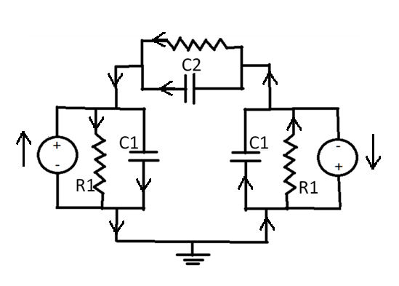
I₄
R2
I₂+I₃-I₁-I₄
I₂
I₂
I₁
I₁
I₃
I₃

Slide 13
The Charging Curve
Exponential growth
Exponential decay

Slide 14
The Charging Curve
Voltage exceeds a certain level: new paths are opened in the circuit to leak charge
Electrical breakdown
Voltage drops below critical level: Circuit is closed -> Recharge

Slide 15
Maximum Voltage and Insulation
Insulation between rings and buckets is crucial
Ideal Kelvin’s Dropper:
R₂-> Infinity
C₂-> 0
R₁-> Infinity
R2

Slide 16
Maximum Voltage and Ring Position
The maximum voltage and growth constant is larger when the nozzle is nearer to the ring

Slide 17
If nozzle is too near to ring, the maximum voltage and growth rate decreases.

Slide 18
At a flow rate of 250ml, the flow breaks into droplets at 9cm from nozzle

Slide 19
Maximum Voltage and Ring Diameter
The voltage curve for a ring with a smaller radius has a larger maximum voltage.
The voltage curve for a ring with smaller radius has a larger growth constant.

Slide 20
Maximum Voltage and Ring Diameter
Ring diameter
z
R
q

Slide 21
Maximum Voltage and Water Velocity
Higher water velocity decreases the time that the ring is capable of inducing charge
Maximum voltage decreases with increasing water speed
Water velocity increase

Slide 22
Conclusions & Summary
Self amplifying process: analogy to circuit
Insulation is critical:
Parameters affecting the maximum voltage
Ring position: Maximum voltage increases as ring is nearer to the droplet separation range
Ring diameter: Maximum voltage increases with smaller ring diameter

Slide 23
References
Vanderkooy, John. An Electrostatic Experiment of Lord Kelvin with Running Water. Phys 13 news, DP, U of Waterloo, Ontario. January, 1984.
Zahn, Markus. Self-Excited ac High Voltage Generation Using Water Droplets. AJP. Vol 41. pp 196~202. 16, August, 1972.

Slide 24
Thank you

Slide 26
Problem Analysis
Breaking of droplets
Necks will tend to pinch off
P

Slide 27
Concluding Remarks
Estimating the efficiency of Kelvin’s dropper:
According to references: capacitance is picofarad level
10^-6
Types of liquids: similar effect because of ions
Repeatablity

