Slide 1
Introduction For Coil gun
-Barry's Coilgun Design

Slide 2
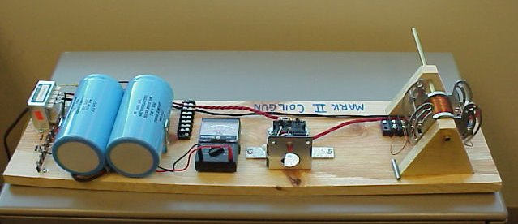
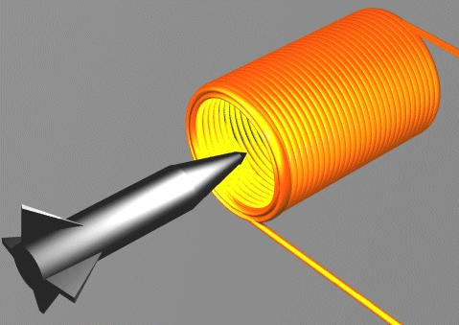
What is a coilgun or gauss gun?
It accelerates a piece of iron or steel down a tube. The tube runs through a series of electromagnetic coils (like solenoids).

Slide 3
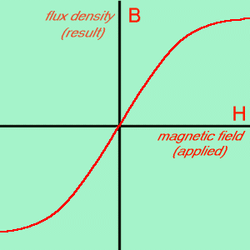
Introduction
Magnetic Materials
Solenoid Physics
Magnetic Field
Force From Magnetism
＊ Force Is the Gradient of Potential Energy
＊ The potential energy in a magnetic field is
Saturation
＊ The B-H curve here illustrates the effect of magnetic
saturation. It shows the effect of applying an external
magnetic field to unmagnetized iron.

Slide 4
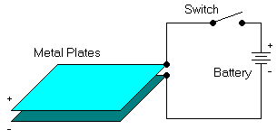
Introduction
Capacitors
Energy Storage
＊The charge or quantity of electricity that can be held in the electric field
between the capacitor plates is proportional to the applied voltage and to the
capacitance of the capacitor: Q = C * V where
Q = charge in coloumbs
C = capacitance in farads
V = voltage in volts
＊The energy stored in a capacitor is also a function of voltage and
capacitance: W = V² * C / 2 where
W = energy in joules (watt-seconds)
V = voltage in volts
C = capacitance in farads

Slide 5
Capacitor Charge and Discharge
q
I
cε
I₀=V₀/R
I₀=ε/R
0.63cε
τ=RC
0.37I₀
t
t
τ
τ
Capacitor Charge q-t plot
Capacitor Charge I-t plot
q
I
τ
t
cε
0.37I₀
I₀=ε/R
0.37cε
τ
t
Capacitor Discharge q-t plot
Capacitor Discharge I-t plot
National taiwan normal university

Slide 6
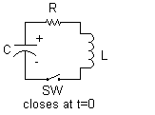
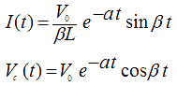
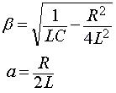
Introduction
Inductors (Coilgun)
＊The symbol and defining equation for an inductor is
,where L is called the inductance.
Damped Oscillator (RLC)
＊The voltage V and current I as a function of time

Slide 7
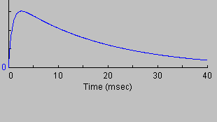
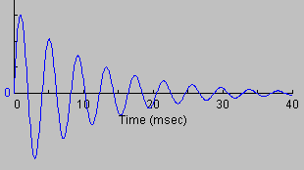
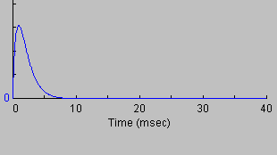
Introduction
Critical Damping
＊When R²C²-4LC is positive, then α and β are real
numbers and the oscillator is over-damped. The
circuit does not show oscillation.
＊When R²C²-4LC is negative, then α and β are
imaginary numbers and the oscillations are
under-damped. The circuit responds with
a sine wave in an exponential decay envelope.
＊When R²C²-4LC is zero, then α and β are zero
and oscillations are critically damped. The
circuit response shows a narrow peak followed
by an exponential decay.

Slide 8
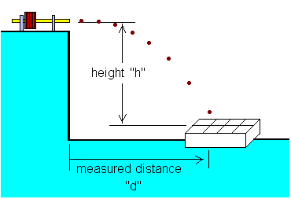
Introduction
Measuring Coilgun Speed
＊ Horizontal Ballistic Speed Trap
If you fire the coilgun horizontally off a table, and measure the distance to where it lands, and the height it fell, then you have enough information to calculate the speed.
＊ speed = d * SQRT(g / 2h) 1
where d is horizontal distance in feet (or meters) and h is vertical distance in feet (or meters) and SQRT is the square root function

Slide 9
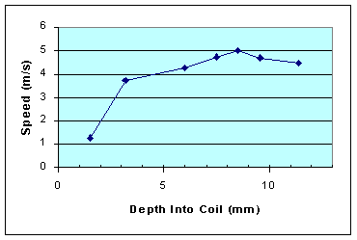
Barry's Coilgun (1)
Result: Position
＊The exit speed is quite sensitive to the projectile's precise starting position. It takes only a few millimeters further in or out to gain or loose significant speed. This graph shows the measured speed compared to how far the projectile was inserted into the coil.
Dist (x) | Muzzle Speed
18.6mm | 4.46 m/s
20.4 | 4.67
21.5 | 5.00 m/s
22.5 | 4.73
24.0 | 4.26
26.8 | 3.73
28.5 | 1.25

Slide 10
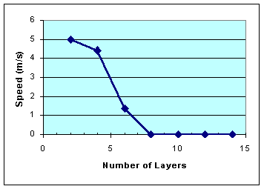
Barry's Coilgun (1)
Result: Turns
＊ The timing is entirely controlled by the inductance and capacitance. The coil should be wound with taps at various layers, so you can choose the number of turns and therefore the inductance.
Layers | Result
14 | strong snap to middle of coil
12 | strong snap to middle of coil
10 | strong snap to middle of coil
8 | strong snap, fell out wrong end
6 | 1.39 m/s forward
4 | 4.41 m/s
2 | 5.00 m/s

Slide 11
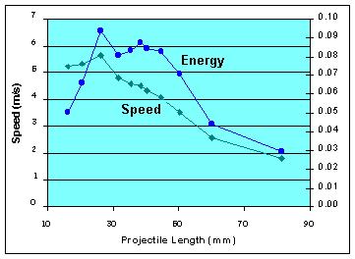
Barry's Coilgun (1)
Result: Length
Length | Speed | Energy
16.3mm | 5.24 ms/s | 0.0501 J
20.6 | 5.34 | 0.0659
26.2 | 5.64 | 0.0936
31.5 | 4.78 | 0.0808
35.4 | 4.58 | 0.0832
38.4 | 4.51 | 0.0875
40.3 | 4.32 | 0.0845
44.7 | 4.07 | 0.0831
50.3 | 3.53 | 0.0704
60.0 | 2.56 | 0.0442
81.3 | 1.80 | 0.0295

Slide 12
Barry's Coilgun (1)
Results - External Iron
＊This coilgun was built with iron washers at each end to help focus the magnetic
field.
Conclusions
This coilgun works best with no external iron.
With Iron | Without Iron
4.78 m/s | 5.93 m/s

Slide 13
Barry's Coilgun (1)
Result: Tube
＊Does the material of the firing tube have any effect?
＊In running this test, I discovered the plastic firing tube made a dramatic 24% improvement in exit speed. This tells us the eddy currents are very significant! We can expect the energy losses in eddy currents to get much higher as we move to shorter firing times, since eddy currents increase with frequency.
Conclusions
＊This coilgun worked 24% better with a plastic non-conductive firing tube. This was the single biggest performance gain of any changes I've tried! The plastic tube was inexpensive, but other materials and construction techniques should also produce the same benefit.
Brass Tube | Plastic Tube
4.78 m/s | 5.93 m/s

Slide 14
Barry's Coilgun (1)
Result: Tube
＊Eddy Currents
The large and rapid flux changes will induce surface currents in the conductive projectile. Eddy currents always act against the applied magnetic field, reducing the absorbed kinetic energy.
Eddy currents are an important effect; a much earlier coilgun found a 24% reduction in velocity due to eddy currents in a brass firing tube. Since then, we have only used non-conductive firing tubes such as the plastic ones in this coilgun.

Slide 15
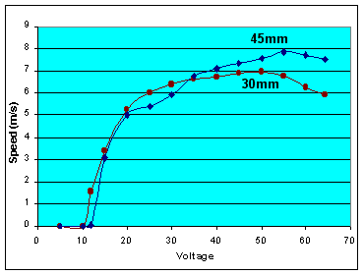
Barry's Coilgun (1)
Result: Voltage
Volts | 30mm Speed | 45mm Speed
5v | 0 | 0
10v | 0 | 0
12v | 1.56 m/s | 0.07 m/s
15v | 3.40 | 3.06
20v | 5.24 | 5.00
25v | 6.01 | 5.42
30v | 6.40 | 5.90
35v | 6.61 | 6.80
40v | 6.74 | 7.09
45v | 6.91 | 7.34
50v | 6.96 | 7.60
55v | 6.75 | 7.85
60v | 6.26 | 7.71
64v | 5.91 | 7.51
Conclusions -
Notice the sharp knee around 20 to 30 volts.
Then only 10% gain is achieved when the voltage
is doubled to 60 volts. A reasonable tuning strategy is
to gradually increase the voltage until this knee is identified.
Further voltage increases will stress the circuitry without
providing significant benefits.

Slide 16
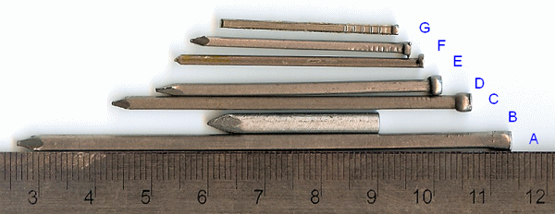
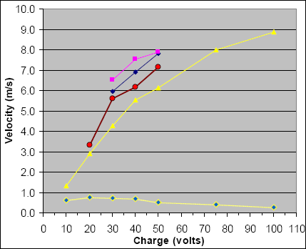
Barry's Coilgun (2)
Projectiles
Result: Coil of 97 Turns (velocity)
Projectile: |  | A | C | D | F
Potential energy (joules) | Charge (volts) | Velocity (m/s) | Velocity (m/s) | Velocity (m/s) | Velocity (m/s)
0.6 J | 10 v | 1.316 | - | - | -
2.4 | 20 | 2.919 | 3.319 | - | -
5.4 | 30 | 4.292 | 5.609 | 5.952 | 6.524
9.6 | 40 | 5.551 | 6.181 | 6.925 | 7.554
15.0 | 50 | 6.124 | 7.154 | 7.840 | 7.898
33.8 | 75 | 8.012 | - | - | -
60.0 | 100 | 8.871 | - | - | -

Slide 17
Barry's Coilgun (2)
Result: Coil of 97 Turns (Efficiency)
Projectile: |  | A | C | D | F
Potential energy (joules) | Charge (volts) | Efficiency (%) | Efficiency (%) | Efficiency (%) | Efficiency (%)
0.6 J | 10 v | 0.6 % | - | - | -
2.4 | 20 | 0.8 | 0.5 | - | -
5.4 | 30 | 0.7 | 0.6 | 0.5 | 0.3
9.6 | 40 | 0.7 | 0.4 | 0.4 | 0.2
15.0 | 50 | 0.5 | 0.4 | 0.3 | 0.2
33.8 | 75 | 0.4 | - | - | -
60.0 | 100 | 0.3 | - | - | -

Slide 18
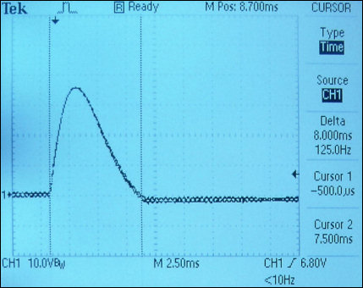
Barry's Coilgun (2)
Coil of 97 Turns Analysis

Slide 19
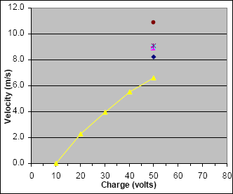
Barry's Coilgun (2)
Result: Coil of 84 Turns (velocity)
Projectile: |  | A | C | D | E | F | G
Potential energy (joules) | Charge (volts) | Velocity (m/s) | Velocity (m/s) | Velocity (m/s) | Velocity (m/s) | Velocity (m/s) | Velocity (m/s)
0.6 J | 10 v | 0.0 | - | - | - | - | -
2.4 | 20 | 2.289 | - | - | - | - | -
5.4 | 30 | 3.949 | - | - | - | - | -
9.6 | 40 | 5.494 | - | - | - | - | -
15.0 | 50 | 6.581 | 8.241 | 8.871 | 8.985 | 9.100 | 10.874

Slide 20
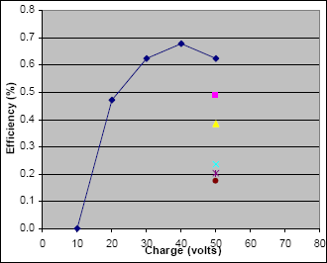
Barry's Coilgun (2)
Result: Coil of 84Turns (Efficiency)
Projectile: |  | A | C | D | E | F | G
Potential energy (joules) | Charge (volts) | Efficiency (%) | Efficiency (%) | Efficiency (%) | Efficiency (%) | Efficiency (%) | Efficiency (%)
0.6 J | 10 v | 0.0 % | - | - | - | - | -
2.4 | 20 | 0.5 | - | - | - | - | -
5.4 | 30 | 0.6 | - | - | - | - | -
9.6 | 40 | 0.7 | - | - | - | - | -
15.0 | 50 | 0.6 | 0.5 | 0.4 | 0.2 | 0.2 | 0.2

Slide 21
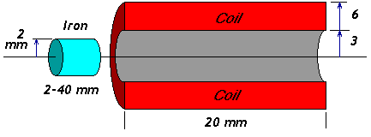
Finite Element Magnetics
you can analyze coilguns without building them and study effects that you can't build, by using finite element analysis (FEA) software and simulate your coilgun.

Slide 22
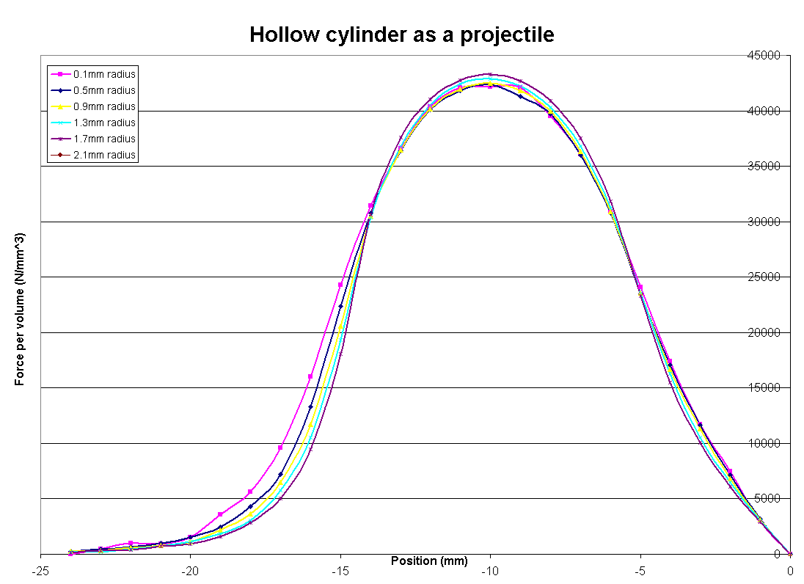
Finite Element Magnetics
FEM Models - Hollow Cylinder Projectile
＊The graphs for seven different projectiles are practically on top of one another. Therefore, the force per unit of mass does not depend on the inside radius of a hollow cylinder of iron.

Slide 23
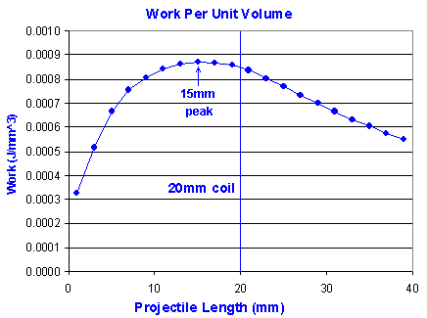
Finite Element Magnetics
FEM Models - Projectile Length
＊These results confirm the
rule-of-thumb that projectiles
should be about the same length
as the coil.

Slide 24
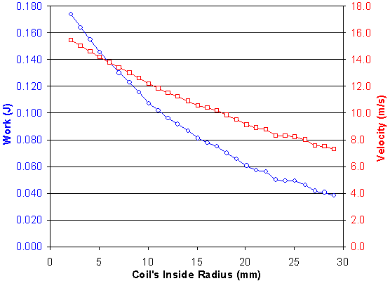
Finite Element Magnetics
FEM Models - Coil Diameter
＊ Smaller openings are better than bigger coils. In fact, smaller is always better. The graph proves that minimizing the air gap is important.
＊ The energy transfer is not very sensitiveto coil opening size.

Slide 25
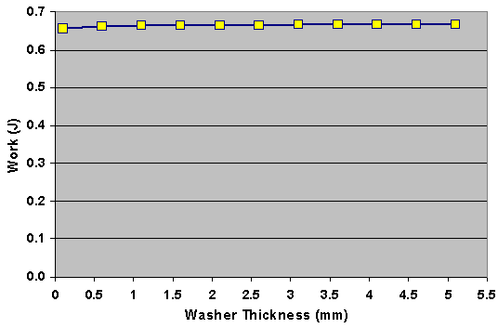
Finite Element Magnetics
FEM Models -Iron at Coil Entry
＊ There is no dependence on work and washer thickness. The total kinetic energy is practically the same for every washer!
Thickness (mm) | Work (Joules)
0.1 | 204.8
0.6 | 204.9
1.1 | 204.8
1.6 | 204.7
2.1 | 204.9
2.6 | 205.0
3.1 | 204.7
3.6 | 204.7
4.1 | 204.9
4.6 | 204.8
5.1 | 204.9

Slide 26
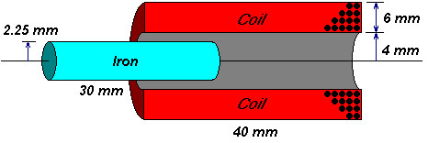
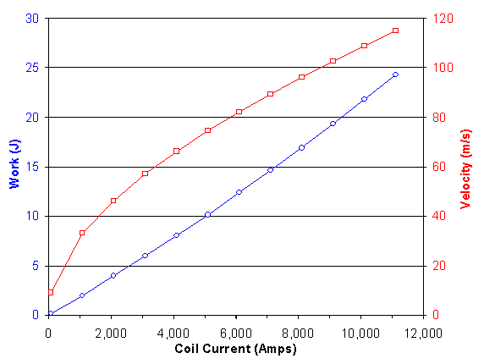
Finite Element Magnetics
FEM Models - Coil Current

