Slide 1
Report 13
Shrieking rod
知物達理隊
劉富蘭克林 儲君宇 葉星佑 黃奕立 郭潔恩

Slide 2
Problem # 13
Shrieking rod
A metal rod is held between two fingers and hit. Investigate how the sound produced depends on the position of holding and hitting the rod?

Slide 3
Overview
Introduction
  Observation
  Problem Analysis
Experiment
  Experimental Setup
  Experiment
Results and Discussion
Conclusions & Summary
References

Slide 4
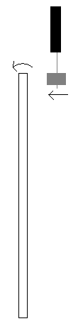
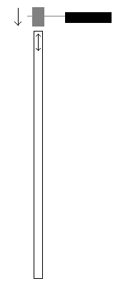
Introduction
Observation
Two obvious modes of vibration:
1.Transverse motion
(Lower frequency)
2. longitudinal motion
(higher frequency)
video
video

Slide 5
Introduction
Problem Analysis
1. Transverse motion compresses air near rod.
-> Amplitude and frequency of sound produced thus depends on elastic modulus of rod.
Statics
Dynamics

Slide 6
Introduction
Quantitative Analysis
Statics
Rod is composed of many parallel fibers
Fibers above neutral surface are stretched and fibers below it are compressed.

Slide 7
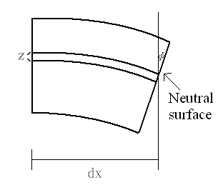
Definition of stress and strain:
A filament under the neutral
surface by distance z, with a cross section is stretched a length:
Tensile force of particular filament:
Torque of particular filament:

Slide 8
The bending moment, which is the amount of force it takes to bend the whole segment by an angle of is:
Also,

Slide 9
Introduction
For a circular cross section,
( depends only on shape of cross section because is a geometrical quality)
Let:
Then M can be written as:

Slide 10
Introduction
Dynamics
If we consider a shearing force on the end of in a state of equilibrium :

Slide 11
Introduction
The differential equation of the motion of the bar:
General solution:
Predicted frequency:

Slide 12
Introduction
For a stainless steel rod (S347) with a length 1m and diameter 0.6 cm, and plugging in actual data, the first harmonic predicted is:
second harmonic predicted:
Third harmonic predicted:

Slide 13
Introduction
For an bronze rod of the same specifications, the predicted first harmonic is:
second harmonic predicted:
Third harmonic predicted:

Slide 14
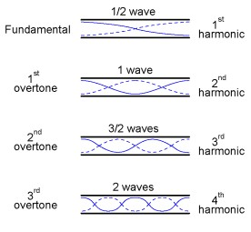
Introduction
2. Longitudinal waves:
Frequency depends on
length of rod allowed to vibrate.
The speed of sound in the longitudinal direction.
Unfixed ends: antinodes of the standing wave
Length of the rod is a multiple of a half of the wavelength: .

Slide 15
Introduction
Velocity of longitudinal wave
,
The shorter the vibrating length, the higher the frequency produced.

Slide 16
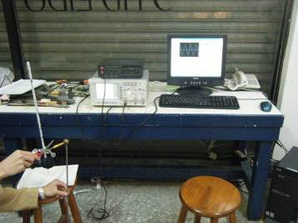
Experiment Setup
Rods
Mallet
Oscilloscope and
computer

Slide 17
Experiment
Parameters:
Rod material:
  Stainless steel
  Bronze
Rod diameter:
  50cm, 6mm stainless steel rod
  50cm ,12mm stainless steel rod
Rod length:
  40cm stainless steel, bronze rods
  50cm stainless steel , bronze rods
  90cm stainless steel , bronze rods
Position of holding rod:
  half length
  quarter length
  sixth length
Method of hitting rod:
  Hit across rod
  Hit along rod

Slide 18
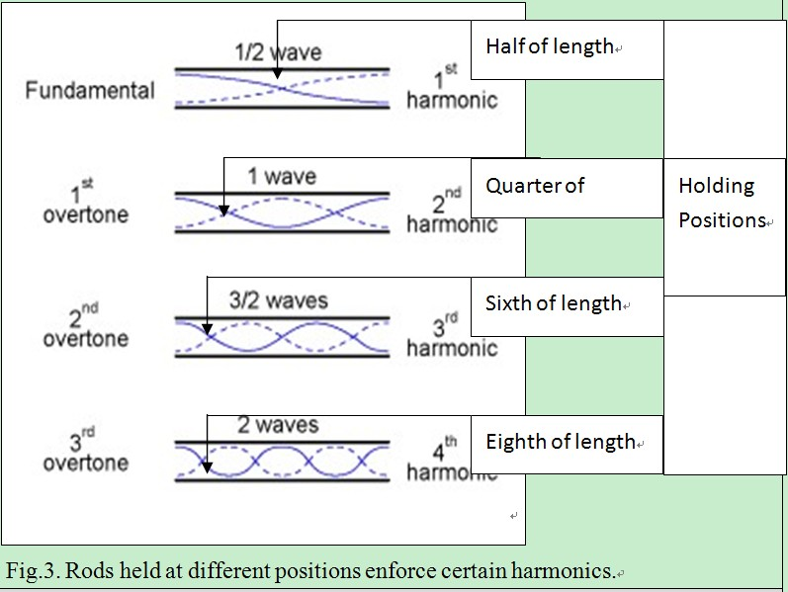
Introduction

Slide 19
Experiment
Waveform data of 6mm bronze rod held at half point

Slide 20
Experiment
Fourier transform for waveform data, with main peak at 17.0, representing 3400 Hz

Slide 21
Hit along rod: longitudinal waves
Theory fits well with data in low frequency range
The microphone and oscilloscope cannot pick up signals over 10 kHz, and may not be precise in the high frequency range

Slide 22
Hit across rod: Transverse waves
Rod holding position | 1/2 | 1/4 | 1/6
Stainless Steel, d=6mm | 285.7Hz | 102.9Hz | 303.6Hz
Stainless Steel, d=12mm | 600.6Hz | 219.8Hz | 232.9Hz
Bronze, d=6mm | 197.2Hz | 72.15Hz | 202Hz
501cm bronze rod:
First harmonic: 7.9 Hz (too low)
Second harmonic: 71.5
Third harmonic: 198.6

Slide 23
Holding certain points on the rod enforces certain harmonics:
Holding half point enforces 1st harmonic, however, the frequency is too low to hear
Holding sixth point can enforce 3rd harmonic
Holding half point can also enforce 3rd harmonic
3rd
3rd
2nd
Holding quarter point can enforce 2nd harmonic

Slide 24
3rd
3rd
2nd
Stainless Steel, d=6mm | 285.7Hz | 102.9Hz | 303.6Hz
theoretical | 298.3Hz | 107.4Hz | 298.3Hz
Stainless Steel, d=12mm | 600.6Hz | 219.8Hz | 232.9Hz
theoretical | 596.5Hz | 214.8Hz | 596.5Hz
Bronze, d=6mm | 197.2Hz | 72.15Hz | 202Hz
theoretical | 198.6Hz | 71.5Hz | 198.6Hz

Slide 25
Results and discussion
12mm rod is too thick to completely control with one hand-> more complications
Other data points fall within good range with the theory
The theory proves an accurate method to estimate the frequency a thin shrieking rod produces

Slide 26
Conclusions & Summary
For longitudinal waves, the frequencies each rod produces are multiples of the first harmonic. The theory for longitudinal waves is in accordance with experimental data.
For transverse waves, our theory considering the bending moment of the rod accurately predicts the harmonics of thin rods in a wide range, including rods of different material, length and holding position.

Slide 27
Thank you
劉富蘭克林
儲君宇
黃奕立
葉星佑
郭潔恩

